Slide 1
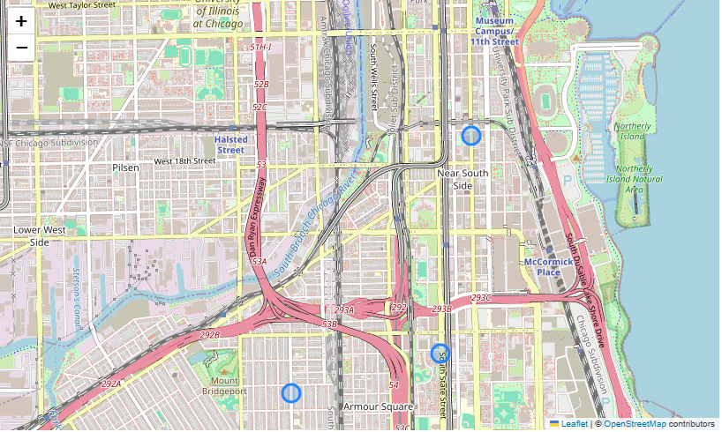
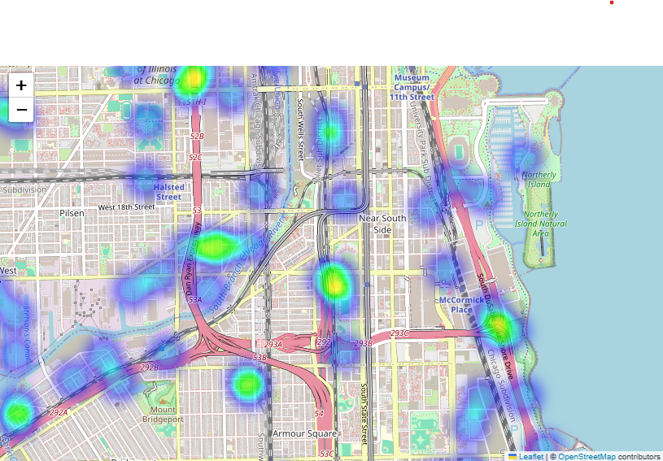
Theft Occurrence in Chicago’s South Loop
Data shows an intensity in thefts in Chicago’s South Loop and Hyde Park neighborhoods.
Key Findings:
Near South Side theft hotspots show an
Increase near public transportation
Increase in intensity along the south side
lake shore
Data Source: “Chicago Crimes” https://www.kaggle.com/datasets/currie32/crimes-in-chicago/data| | Kaggle

